Slide 1
Hibernate / JPA Overview

Slide 2
Topics
•
What is Hibernate?
•
Benefits of Hibernate
•
What is JPA?
•
Benefits of JPA
•
Code Snippets

Slide 3


What is Hibernate?
•
A framework for persisting / saving Java objects in a database
•
www.hibernate.org/orm
Your Java App
Hibernate

Slide 4
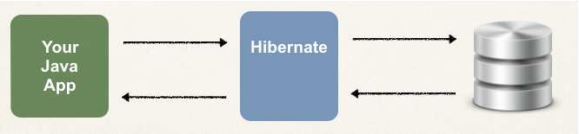
Benefits of Hibernate
•
Hibernate handles all of the low-level SQL
•
Minimizes the amount of JDBC code you have to develop
•
Hibernate provides the Object-to-Relational Mapping (ORM)

Slide 5
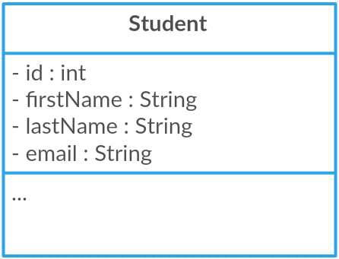
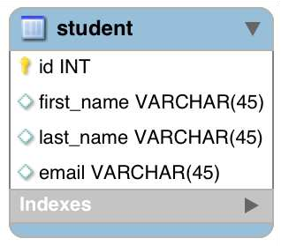
Object-To-Relational Mapping (ORM)
The developer defines mapping between Java class and database table
Java Class
Database Table
Hibernate

Slide 6
What is JPA?
Jakarta Persistence API (JPA) … previously known as Java Persistence API
Standard API for Object-to-Relational-Mapping (ORM)
•
Only a specification
•
Defines a set of interfaces
•
Requires an implementation to be usable

Slide 7


JPA - Vendor Implementations
JPA Spec
Hibernate
EclipseLink

Slide 8
What are Benefits of JPA
By having a standard API, you are not locked to vendor's implementation
•
Maintain portable, flexible code by coding to JPA spec (interfaces)
•
Can theoretically switch vendor implementations
•
For example, if Vendor ABC stops supporting their product
•
You could switch to Vendor XYZ without vendor lock in

Slide 9

JPA - Vendor Implementations
My Biz App
JPA Spec
Hibernate EclipseLink

Slide 10




Saving a Java Object with JPA
// create Java
object
Student theStudent = new Student("Paul", "Doe", "paul@xxx.com");
// save it to database
entityManager.persist(theStudent);
Special JPA helper object
The data will be stored in the database
SQL insert

Slide 11


Retrieving a Java Object with JPA
// create Java object
Student theStudent = new Student("Paul", "Doe", "paul@xxx.com");
// save it to database
entityManager.persist(theStudent);
// now retrieve from database using
the primary key
int theId = 1;
Student myStudent = entityManager.find(Student.class, theId);
Query the database for given id

Slide 12


Querying for Java Objects
TypedQuery<Student> theQuery = entityManager.createQuery("from Student", Student.class);
List<Student> students= theQuery.getResultList();
Returns a list of Student objects from the database

Slide 13





JPA/Hibernate CRUD Apps
•
Create objects
•
Read objects
Update objects
Delete objects
Your Java App
JPA
Hibernate
•
•

Slide 14
Hibernate / JPA and JDBC

Slide 15



How does Hibernate / JPA relate to JDBC?

Slide 16


Hibernate / JPA and JDBC
•
Hibernate / JPA uses JDBC for all database communications
JPA
Hibernate
Your Java App
JDBC

Slide 17
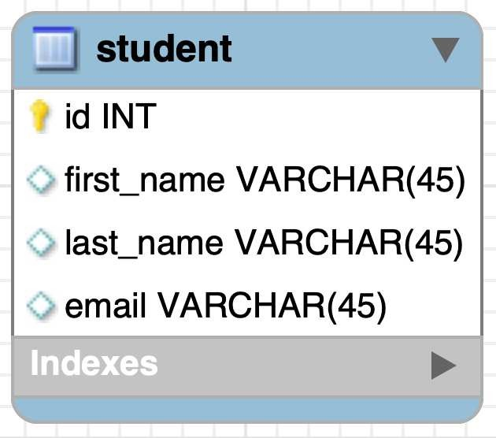
About: 02-student-tracker.sql
1. Create a new database table: student
www.luv2code.com

Slide 18
Setting Up Spring Boot Project

Slide 19
Automatic Data Source Configuration
In Spring Boot, Hibernate is the default implementation of JPA
•
EntityManager is main component for creating queries etc …
•
EntityManager is from Jakarta Persistence API (JPA)

Slide 20
Automatic Data Source Configuration
Based on configs, Spring Boot will automatically create the beans:
DataSource, EntityManager, …
•
You can then inject these into your app, for example your DAO

Slide 21
Setting up Project with Spring Initialzr
At Spring Initializr website, start.spring.io
Add dependencies
MySQL Driver: mysql-connector-j
Spring Data JPA: spring-boot-starter-data-jpa

Slide 22
Spring Boot - Auto configuration
Spring Boot will automatically configure your data source for you
•
Based on entries from Maven pom file
•
JDBC Driver: mysql-connector-j
•
Spring Data (ORM): spring-boot-starter-data-jpa
•
DB connection info from application.properties

Slide 23


application.properties
spring.datasource.url=jdbc:mysql://localhost:3306/student_tracker spring.datasource.username=springstudent spring.datasource.password=springstudent
No need to give JDBC driver class name Spring Boot will automatically detect it based on URL

Slide 24
Creating Spring Boot - Command Line App
We will create a Spring Boot - Command Line App
This will allow us to focus on Hibernate / JPA
Later in the course, we will apply this to a CRUD REST API

Slide 25





Creating Spring Boot - Command Line App
import import import import
org.springframework.boot.CommandLineRunner; org.springframework.boot.SpringApplication; org.springframework.boot.autoconfigure.SpringBootApplication; org.springframework.context.annotation.Bean;
@SpringBootApplication
public class CruddemoApplication {
Executed after the
Spring Beans have been loaded
public static void main(String[] args) { SpringApplication.run(CruddemoApplication.class,
}
args);
@Bean
public CommandLineRunner commandLineRunner(String[] return runner -> {
System.out.println("Hello world");
};
}
Lambda expression
args) {
Add our custom code
}

Slide 26
JPA Development Process

Slide 27
JPA Dev Process - To Do List
Annotate Java Class
Develop Java Code to perform database operations

Slide 28
Let’s just say “JPA”
As mentioned, Hibernate is the default JPA implementation in Spring Boot
•
Going forward in this course, I will simply use the term: JPA
•
Instead of saying “JPA Hibernate”
•
We know that by default, Hibernate is used behind the scenes
www.luv2code.com

Slide 29
Terminology
Entity Class
Java class that is mapped to a database table
www.luv2code.com

Slide 30
Object-to-Relational Mapping (ORM)
Java Class
Database Table
JPA
www.luv2code.com

Slide 31
Entity Class
At a minimum, the Entity class
Must be annotated with @Entity
Must have a public or protected no-argument constructor
The class can have other constructors

Slide 32
Constructors in Java - Refresher
Remember about constructors in Java
If you don’t declare any constructors
Java will provide a no-argument constructor for free
•
If you declare constructors with arguments
•
then you do NOT get a no-argument constructor for free
•
In this case, you have to explicitly declare a no-argument constructor

Slide 33
Java Annotations
Step 1: Map class to database table
Step 2: Map fields to database columns

Slide 34

Step 1: Map class to database table
@Entity @Table(name="student") public class Student {
...
Java Class
Database Table
}

Slide 35

Step 2: Map fields to database columns
@Entity @Table(name="student") public class Student {
@Id @Column(name="id") private int id;
Java Class
Database Table
@Column(name="first_name")
private String firstName;
…
}

Slide 36
@Column - Optional
Actually, the use of @Column is optional
If not specified, the column name is the same name as Java field
In general, I don’t recommend this approach
If you refactor the Java code, then it will not match existing database columns
This is a breaking change and you will need to update database column
•
Same applies to @Table, database table name is same as the class

Slide 37
Terminology
Primary Key
Uniquely identifies each row in a table Must be a unique value
Cannot contain NULL values

Slide 38
JPA Identity - Primary Key
@Entity @Table(name="student") public class Student {
@Id @GeneratedValue(strategy=GenerationType.IDENTITY) @Column(name="id")
private int id;
…
}

Slide 39





ID Generation Strategies
Name | Description
GenerationType.AUTO | Pick an appropriate strategy for the particular database
GenerationType.IDENTITY | Assign primary keys using database identity column
GenerationType.SEQUENCE | Assign primary keys using a database sequence
GenerationType.TABLE | Assign primary keys using an underlying database table to ensure uniqueness
www.luv2code.com

Slide 40
Bonus Bonus
•
You can define your own CUSTOM generation strategy :-)
•
Create implementation of
org.hibernate.id.IdentifierGenerator
•
Override the method: public Serializable generate(…)

Slide 41
Save a Java Object

Slide 42

Sample App Features
Create a new Student
Read a Student
Update a Student
Delete a Student
CRUD

Slide 43
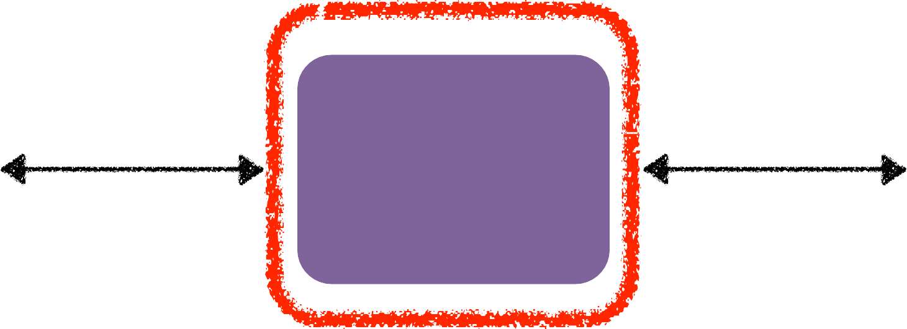


Student Data Access Object
Responsible for interfacing with the database
This is a common design pattern: Data Access Object (DAO)
Data Access Object
Cruddemo App
Student DAO

Slide 44









Student Data Access Object
Methods
save(…)
findById(…)
findAll()
findByLastName(…)
update(…)
delete(…)
deleteAll()

Slide 45



Student Data Access Object
✤
Our DAO needs a JPA Entity Manager
✤
JPA Entity Manager is the main component for saving/retrieving entities
Data Access Object
Student DAO
Entity Manager
…

Slide 46



JPA Entity Manager
Our JPA Entity Manager needs a Data Source
The Data Source defines database connection info
JPA Entity Manager and Data Source are automatically created by Spring Boot
Based on the file: application.properties (JDBC URL, user id, password, etc …)
We can autowire/inject the JPA Entity Manager into our Student DAO
Data Access Object
Student DAO
Entity Manager
Data Source

Slide 47



Student DAO
Step 1: Define DAO interface
Step 2: Define DAO implementation
Inject the entity manager
Step 3: Update main app
Data Access Object
Step-By-Step
Student DAO
Entity Manager
Data Source

Slide 48

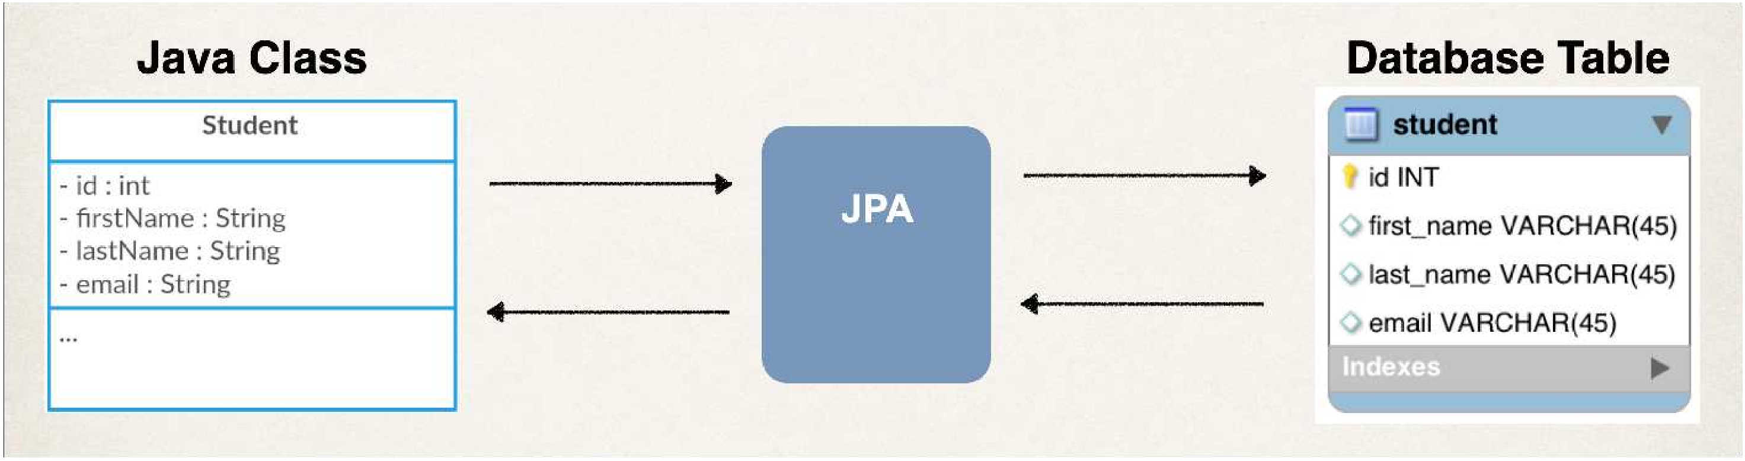
Step 1: Define DAO interface
import
com.luv2code.cruddemo.entity.Student;
public interface StudentDAO {
void save(Student theStudent);
}

Slide 49

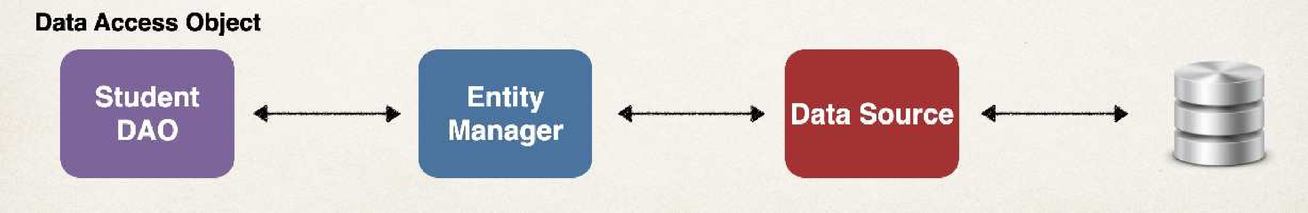





Step 2: Define DAO implementation
import import import
com.luv2code.cruddemo.entity.Student; jakarta.persistence.EntityManager; org.springframework.beans.factory.annotation.Autowired;
public class StudentDAOImpl implements StudentDAO {
private EntityManager entityManager;
Inject the Entity Manager
@Autowired
public StudentDAOImpl(EntityManager theEntityManager) { entityManager = theEntityManager;
}
@Override
public void save(Student theStudent) { entityManager.persist(theStudent);
}
Save the Java object
}

Slide 50
Spring @Transactional
Spring provides an @Transactional annotation
•
Automagically begin and end a transaction for your JPA code
•
No need for you to explicitly do this in your code
•
This Spring magic happens behind the scenes

Slide 51


Step 2: Define DAO implementation
import import import import
com.luv2code.cruddemo.entity.Student; jakarta.persistence.EntityManager; org.springframework.beans.factory.annotation.Autowired; org.springframework.transaction.annotation.Transactional;
public class StudentDAOImpl implements StudentDAO {
private EntityManager entityManager; @Autowired
public StudentDAOImpl(EntityManager theEntityManager) { entityManager = theEntityManager;
}
@Override @Transactional
public void save(Student theStudent) { entityManager.persist(theStudent);
}
Handles transaction management
}
www.luv2code.com

Slide 52
Specialized Annotation for DAOs
Spring provides the @Repository annotation
@Component
@RestController
@Repository
…
www.luv2code.com

Slide 53
Specialized Annotation for DAOs
Applied to DAO implementations
•
Spring will automatically register the DAO implementation
•
thanks to component-scanning
•
Spring also provides translation of any JDBC related exceptions
www.luv2code.com

Slide 54



Step 2: Define DAO implementation
import import import import import
com.luv2code.cruddemo.entity.Student; jakarta.persistence.EntityManager; org.springframework.beans.factory.annotation.Autowired; org.springframework.stereotype.Repository; org.springframework.transaction.annotation.Transactional;
Specialized annotation for repositories
Supports component scanning
@Repository
public class StudentDAOImpl implements StudentDAO {
Translates JDBC exceptions
private EntityManager entityManager;
@Autowired
public StudentDAOImpl(EntityManager theEntityManager) { entityManager = theEntityManager;
}
@Override @Transactional
public void save(Student theStudent) { entityManager.persist(theStudent);
}
}
www.luv2code.com

Slide 55

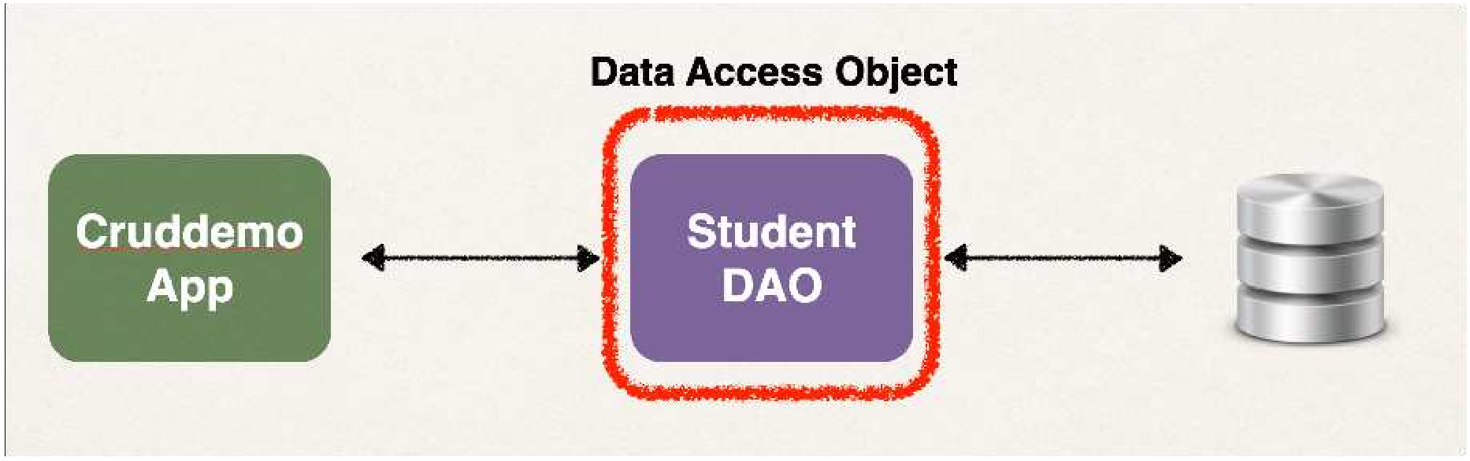




Step 3: Update main app
@SpringBootApplication
public class CruddemoApplication {
public static void main(String[] args) { SpringApplication.run(CruddemoApplication.class, args);
}
Inject the StudentDAO
@Bean
public CommandLineRunner commandLineRunner(StudentDAO studentDAO) { return runner -> {
createStudent(studentDAO);
}
private void createStudent(StudentDAO studentDAO) {
// create the student object
System.out.println("Creating new student object...");
Student tempStudent = new Student("Paul", "Doe", "paul@xxx.com");
// save the student object System.out.println("Saving the student..."); studentDAO.save(tempStudent);
// display id of the saved student
System.out.println("Saved student. Generated id: " + tempStudent.getId());
}
}

Slide 56
Retrieving an Object
© luv2code LLC

Slide 57
JPA CRUD Apps
Create objects
Read objects Update objects Delete objects
•
•
•

Slide 58




Retrieving a Java Object with JPA
// retrieve/read from database using the
// in this example, retrieve Student with
primary key primary key: 1
Student myStudent = entityManager.find(Student.class, 1);
Entity class
Primary key

Slide 59
Development Process
Step-By-Step
Add new method to DAO interface
Add new method to DAO implementation
Update main app

Slide 60

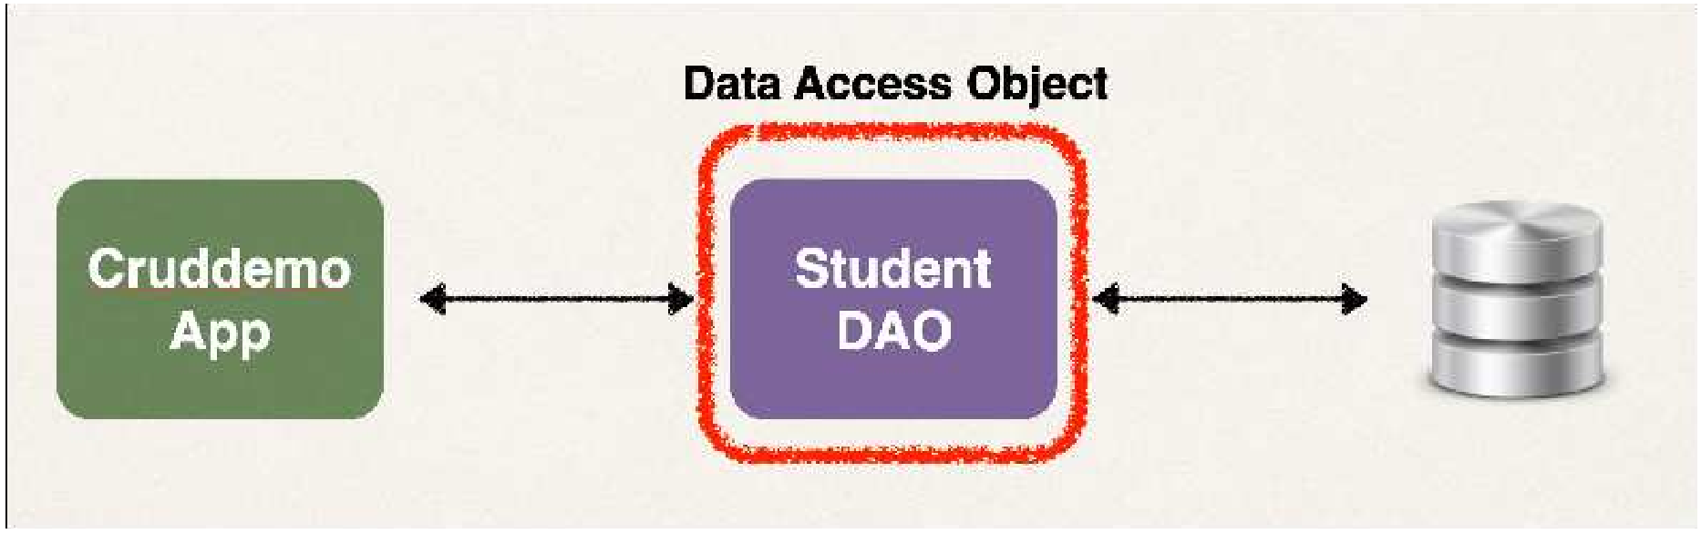
Step 1: Add new method to DAO interface
import com.luv2code.cruddemo.entity.Student;
public interface StudentDAO {
…
Student
findById(Integer
id);
}

Slide 61








Step 2: Define DAO implementation
import import
…
com.luv2code.cruddemo.entity.Student; jakarta.persistence.EntityManager;
public class StudentDAOImpl implements StudentDAO {
No need to add @Transactional
private
…
EntityManager
entityManager;
since we are doing a query
@Override
public Student findById(Integer id) {
return entityManager.find(Student.class, id);
If not found,
}
returns null
}
Entity class
Primary key

Slide 62


Step 3: Update main app
@SpringBootApplication
public class CruddemoApplication {
…
@Bean
public CommandLinerunner commandLinerunner(StudentDAO studentDAO) { return runner -> {
readStudent(studentDAO);
};
}
private void readStudent(StudentDAO studentDAO) {
// create a student object
…
System.out.println("Creating new student object...");
Student tempStudent = new Student("Daffy", "Duck", "daffy@luv2code.com");
// save the student object System.out.println("Saving the student..."); studentDAO.save(tempStudent);
// display id of the saved student
System.out.println("Saved student. Generated id: " + tempStudent.getId());
// retrieve student based on the id: primary key
System.out.println("\nretrieving student with id: " + tempStudent.getId());
Student myStudent = studentDAO.findById(tempStudent.getId()); System.out.println("Found the student: " + myStudent);
}

Slide 63
Query Objects

Slide 64
JPA CRUD Apps
Create objects
Read objects Update objects Delete objects
•
•
•
www.luv2code.com

Slide 65
JPA Query Language (JPQL)
Query language for retrieving objects
•
Similar in concept to SQL
•
where, like, order by, join, in, etc…
•
However, JPQL is based on entity name and entity fields

Slide 66
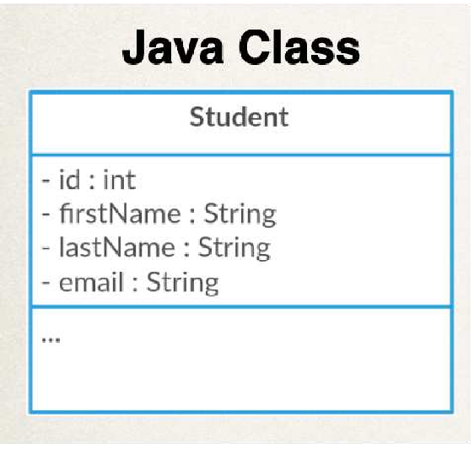




Retrieving all Students
Name of JPA Entity … the class name
TypedQuery<Student> theQuery = entityManager.createQuery("FROM Student", Student.class); List<Student> students = theQuery.getResultList();
Note: this is NOT the name of the database table
All JPQL syntax is based on entity name and entity fields

Slide 67


Retrieving Students: lastName = ‘Doe’
Field of JPA Entity
TypedQuery<Student>
theQuery
= entityManager.createQuery(
"FROM Student WHERE lastName=‘Doe’", Student.class);
List<Student> students = theQuery.getResultList();

Slide 68



Retrieving Students using OR predicate:
Field of JPA Entity
TypedQuery<Student>
theQuery = entityManager.createQuery(
"FROM Student WHERE lastName=‘Doe’ OR firstName=‘Daffy’", Student.class);
List<Student> students = theQuery.getResultList();
Field of JPA Entity

Slide 69


Retrieving Students using LIKE predicate:
TypedQuery<Student> theQuery = entityManager.createQuery(
"FROM Student WHERE email LIKE ‘%xxx.com’", Student.class);
List<Student> students = theQuery.getResultList();
Match of email addresses that ends with xxx.com

Slide 70




JPQL - Named Parameters
JPQL Named Parameters are prefixed with a colon :
public List<Student> findByLastName(String theLastName) {
TypedQuery<Student> theQuery = entityManager.createQuery(
"FROM Student WHERE lastName=:theData", Student.class);
theLastName);
theQuery.setParameter("theData",
return theQuery.getResultList();
}
Think of this as a placeholder
that is filled in later

Slide 71
Development Process
Step-By-Step
Add new method to DAO interface
Add new method to DAO implementation
Update main app
www.luv2code.com

Slide 72
Step 1: Add new method to DAO interface
import com.luv2code.cruddemo.entity.Student; import java.util.List;
public interface StudentDAO {
…
List<Student> findAll();
}
www.luv2code.com

Slide 73



Step 2: Define DAO implementation
import import import import
…
com.luv2code.cruddemo.entity.Student; jakarta.persistence.EntityManager; jakarta.persistence.TypedQuery; java.util.List;
public class StudentDAOImpl implements StudentDAO {
private EntityManager entityManager;
…
No need to add @Transactional
since we are doing a query
@Override
public List<Student> findAll() {
TypedQuery<Student> theQuery = entityManager.createQuery(“FROM Student", Student.class); return theQuery.getResultList();
}
}
Name of JPA Entity

Slide 74

Step 3: Update main app
@SpringBootApplication
public class CruddemoApplication {
public static void main(String[] args) { SpringApplication.run(CruddemoApplication.class, args);
}
@Bean
public CommandLineRunner commandLineRunner(StudentDAO studentDAO) { return runner -> {
queryForStudents(studentDAO);
};
}
private void queryForStudents(StudentDAO studentDAO) {
// get list of students
List<Student> theStudents = studentDAO.findAll();
// display list of students
for (Student tempStudent : theStudents) { System.out.println(tempStudent);
}
}
}

Slide 75
Updating an Object

Slide 76
JPA CRUD Apps
Create objects
Read objects Update objects Delete objects
•
•
•

Slide 77



Update a Student
Student theStudent = entityManager.find(Student.class, 1);
// change first name to "Scooby"
theStudent.setFirstName("Scooby");
entityManager.merge(theStudent);
Update the entity

Slide 78







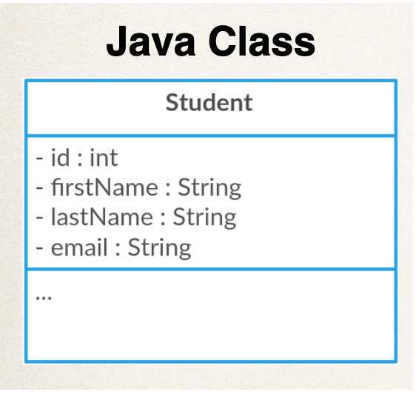
Update last name for all students
Field of JPA Entity
int numRowsUpdated = entityManager.createQuery(
"UPDATE Student SET lastName=‘Tester’”)
.executeUpdate();
Name of JPA Entity … the class name
Return the number of rows updated
Execute this statement

Slide 79
Development Process
Step-By-Step
Add new method to DAO interface
Add new method to DAO implementation
Update main app

Slide 80
Step 1: Add new method to DAO interface
import com.luv2code.cruddemo.entity.Student;
public interface StudentDAO {
…
void
update(Student
theStudent);
}

Slide 81


Step 2: Define DAO implementation
import import import
…
com.luv2code.cruddemo.entity.Student; jakarta.persistence.EntityManager; org.springframework.transaction.annotation.Transactional;
public class StudentDAOImpl implements StudentDAO {
private
…
EntityManager
entityManager;
Add @Transactional since
we are performing an update
@Override @Transactional
public void update(Student theStudent) { entityManager.merge(theStudent);
}
}

Slide 82

Step 3: Update main app
@SpringBootApplication
public class CruddemoApplication {
…
@Bean
public CommandLineRunner commandLineRunner(StudentDAO studentDAO) { return runner -> {
updateStudent(studentDAO);
};
}
private void updateStudent(StudentDAO studentDAO) {
// retrieve student based on the id: primary key
int studentId = 1;
…
System.out.println("Getting student with id: " + studentId);
Student myStudent = studentDAO.findById(studentId); System.out.println("Updating student...");
// change first name to "Scooby" myStudent.setFirstName("Scooby"); studentDAO.update(myStudent);
// display updated student
System.out.println("Updated student: " + myStudent);
}

Slide 83
Deleting an Object

Slide 84
JPA CRUD Apps
Create objects
Read objects Update objects Delete objects
•
•
•

Slide 85
Delete a Student
// | retrieve | the | student
int | id = 1;
Student theStudent = entityManager.find(Student.class, id);
// delete the student
entityManager.remove(theStudent);
www.luv2code.com

Slide 86









Delete based on a condition
Field of JPA Entity
int
numRowsDeleted = entityManager.createQuery(
"DELETE FROM Student WHERE lastName=‘Smith’")
.executeUpdate();
Name of JPA Entity … the class name
Execute this statement
Return the number of rows deleted
Method name “Update” is a generic term
We are “modifying” the database

Slide 87
Delete All Students
int numRowsDeleted
= entityManager
.createQuery("DELETE
.executeUpdate();
FROM
Student")

Slide 88
Development Process
Step-By-Step
Add new method to DAO interface
Add new method to DAO implementation
Update main app

Slide 89
Step 1: Add new method to DAO interface
import com.luv2code.cruddemo.entity.Student;
public interface StudentDAO {
…
void
delete(Integer
id);
}

Slide 90

Step 2: Define DAO implementation
import import import
…
com.luv2code.cruddemo.entity.Student; jakarta.persistence.EntityManager; org.springframework.transaction.annotation.Transactional;
public class StudentDAOImpl implements StudentDAO {
private
…
EntityManager
entityManager;
Add @Transactional since
we are performing a delete
@Override @Transactional
public void delete(Integer
id) {
Student theStudent = entityManager.find(Student.class,
id);
entityManager.remove(theStudent);
}
}

Slide 91


Step 3: Update main app
@SpringBootApplication
public class CruddemoApplication {
…
@Bean public
CommandLineRunner commandLineRunner(StudentDAO studentDAO) {
return runner -> {
deleteStudent(studentDAO);
};
}
private void deleteStudent(StudentDAO
// delete the student
int studentId = 3;
studentDAO) {
…
System.out.println("Deleting student id: " + studentId);
studentDAO.delete(studentId);
}

Slide 92

Create database tables: student
Previously, we created database tables by running a SQL script

Slide 93







Create database tables: student
JPA/Hibernate provides an option to automagically create database tables
Creates tables based on Java code with JPA/Hibernate annotations
Useful for development and testing
Java Code
JPA/Hibernate
SQL
Database

Slide 94
Configuration
In Spring Boot configuration file: application.properties
spring.jpa.hibernate.ddl-auto=create
•
When you run your app, JPA/Hibernate will drop tables then create them
Based on the JPA/Hibernate annotations in your Java code
Definition Language

Slide 95







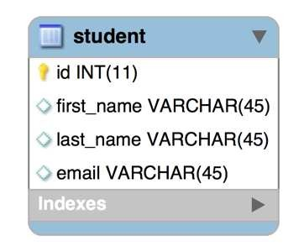

Creating Tables based on Java Code
Hibernate will generate and execute this
2
@Entity @Table(name="student") public class Student {
@Id
1
create table student (id integer not null auto_increment,
email varchar(255), first_name varchar(255), last_name varchar(255), primary key (id))
@GeneratedValue(strategy=GenerationType.IDENTITY) @Column(name="id")
private int id;
@Column(name="first_name") private String firstName;
@Column(name="last_name") private String lastName;
@Column(name="email") private String email;
…
// constructors, getters / setters
}

Slide 96











Configuration - application.properties
spring.jpa.hibernate.ddl-auto=PROPERTY-VALUE
Property Value
Property Description
none
No action will be performed
When database tables are dropped, all data is lost
create-only
Database tables are only created
drop
Database tables are dropped
create
Database tables are dropped followed by database tables creation
create-drop
Database tables are dropped followed by database tables creation. On application shutdown, drop the database tables
validate
Validate the database tables schema
update
Update the database tables schema

Slide 97



Basic Projects
For basic projects, can use auto configuration
spring.jpa.hibernate.ddl-auto=create
•
Database tables are dropped first and then created from scratch
Note:
When database tables are dropped, all data is lost

Slide 98

Basic Projects
If you want to create tables once … and then keep data, use: update
spring.jpa.hibernate.ddl-auto=update
•
However, will ALTER database schema based on latest code updates
•
Be VERY careful here … only use for basic projects

Slide 99

Warning
spring.jpa.hibernate.ddl-auto=create
•
Don't do this on Production databases!!!
•
You don't want to drop your Production data
•
All data is deleted!!!
•
Instead for Production, you should have DBAs run SQL scripts
www.luv2code.com

Slide 100
Use Case
spring.jpa.hibernate.ddl-auto=create
•
Automatic table generation is useful for
•
Database integration testing with in-memory databases
•
Basic, small hobby projects

Slide 101


Recommendation
In general, I don’t recommend auto generation for enterprise, real-time projects
You can VERY easily drop PRODUCTION data if you are not careful
•
I recommend SQL scripts
•
Corporate DBAs prefer SQL scripts for governance and code review
•
The SQL scripts can be customized and fine-tuned for complex database designs
•
The SQL scripts can be version-controlled
•
Can also work with schema migration tools such as Liquibase and Flyway

